Slide 1
Notes:
Share why you chose to host a Clothes Swap with Baptist World Aid and what inspired you.

Slide 2
Notes:
“Overconsumption of clothing creates excessive textile waste, contributes to environmental degradation and furthers worker exploitation. And our nation isn’t exempt from this.”

Slide 3
Notes:
“Our consumption habits play a part in worker and planet exploitation.
By paying only $6.50 per piece of clothing, we fail to recognise the true cost of production, keeping wages low for the workers who make them.
By purchasing 14.8kg of clothes per year, we’re furthering overconsumption as well as revenue for brands that may not operate ethically.
And in throwing away garments after one use or getting rid of items that could be recycled, we’re contributing to 800,000 tonnes of textile waste that ends up in landfill each year.”

Slide 4
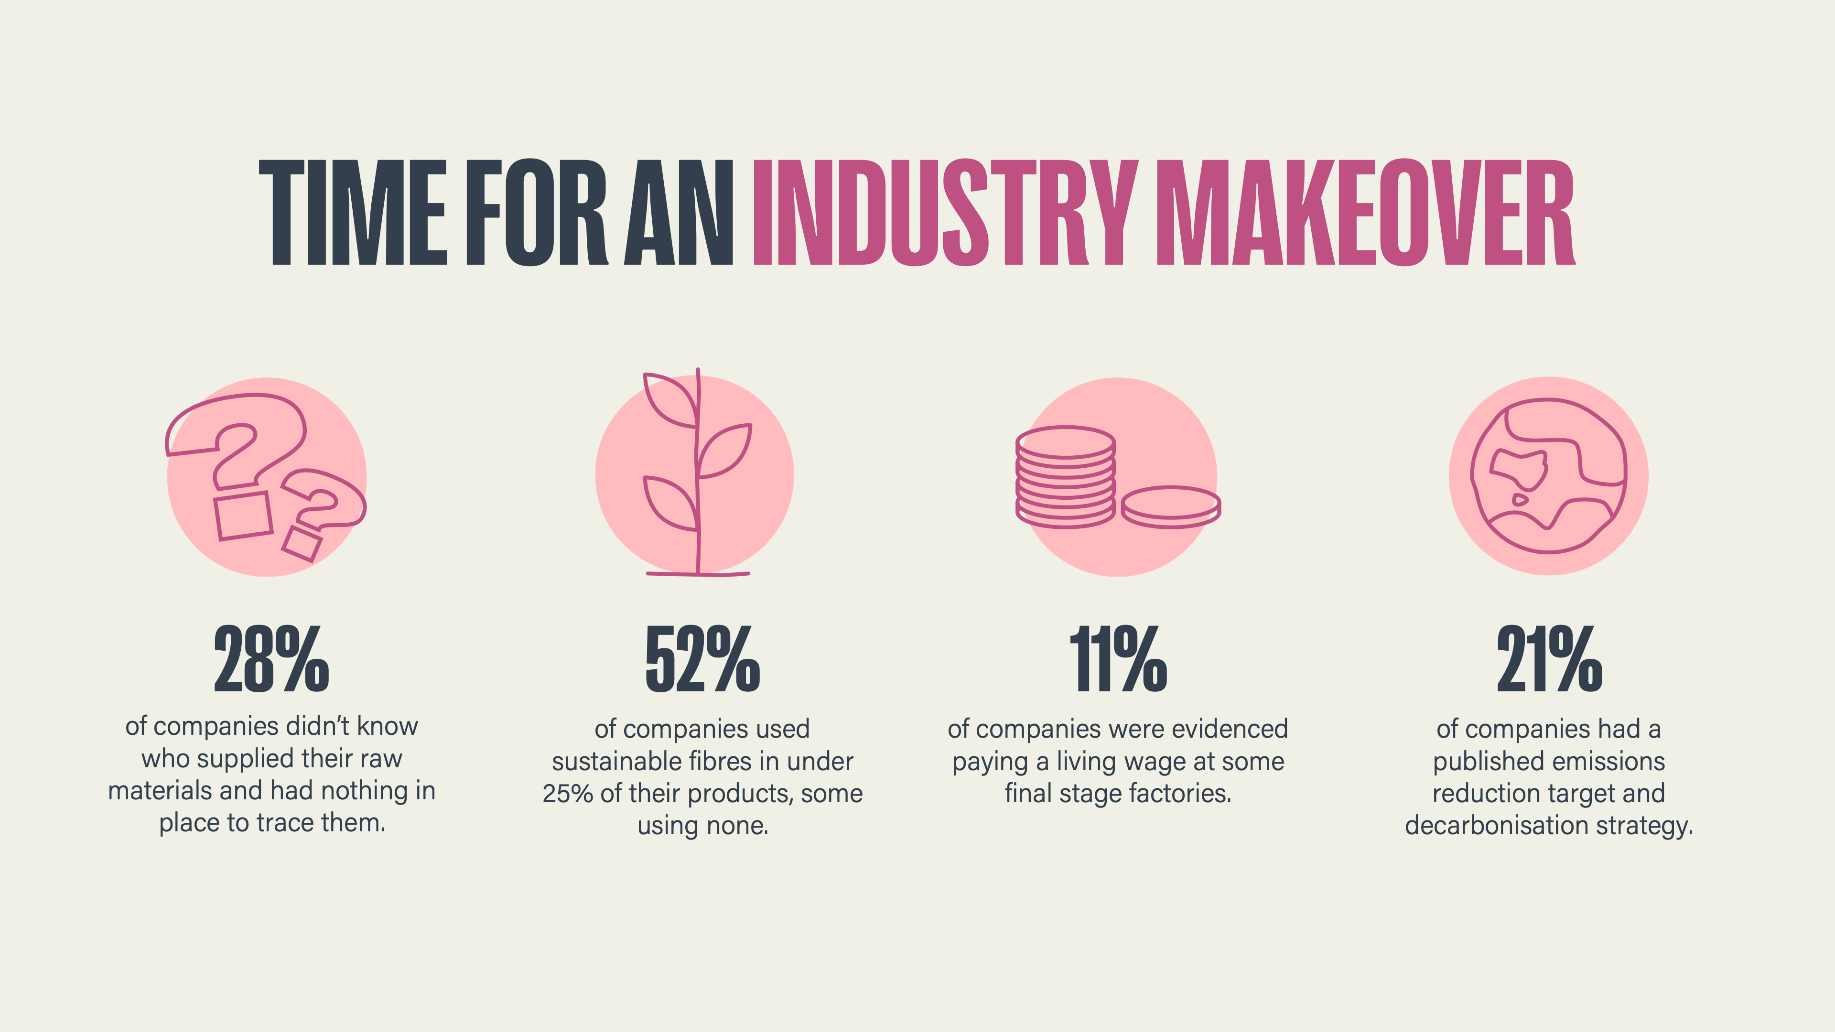
Notes:
“The fashion industry has a responsibility to use ethically sourced and sustainable materials, pay a decent living wage to workers and reduce emissions in their production processes.”

Slide 5
Notes:
“Meet Taslima. She works hard at a cotton mill, mostly making threads to an excellent standard. The machinery she uses is dangerous, and many of her colleagues have had accidents trying to adjust equipment.
Despite risking her safety in these conditions, Taslima is unable to earn a decent living wage to support her family. She shares ‘I cannot fulfill all our needs. With my own earnings, I can’t manage my children’s education or our meals properly’.
How you choose to shop can make a huge difference to lives like Taslima’s.

Slide 6
BWAA.CO/SWAP
Notes:
“Baptist World Aid Australia is an international aid and development organisation, with a vision to see a world where poverty has ended, and all people enjoy the fullness of life God intends. Your gift helps Baptist World Aid … - research fashion brands
- mobilise the community
- campaign for change.”

Slide 7
Notes:
“Big fashion brands should ensure fair working conditions and wages for employees, as well as reduce the environmental impact of their production processes. Brands listen to what their customers want so your voice matters.
Speak out against brands’ unethical practices and use your voice to end worker and planet exploitation. You can make a difference and help create a better world for all.”

