Slide 1

Notes:
Over 1.5 million children currently work on cocoa farms, producing most of the cocoa used by the global chocolate industry. Many are doing hazardous labour, carrying heavy loads, and working long hours. Most of these children are also missing school—trapped in cycles of poverty and child labour.
At the same time, cocoa farmers are not being paid a fair wage, which puts them under pressure to send their kids to work.
As we approach Easter, we remember that God calls us to uphold justice and stand for the vulnerable. This is a simple, practical way our (church or school) can live that out.

Slide 2
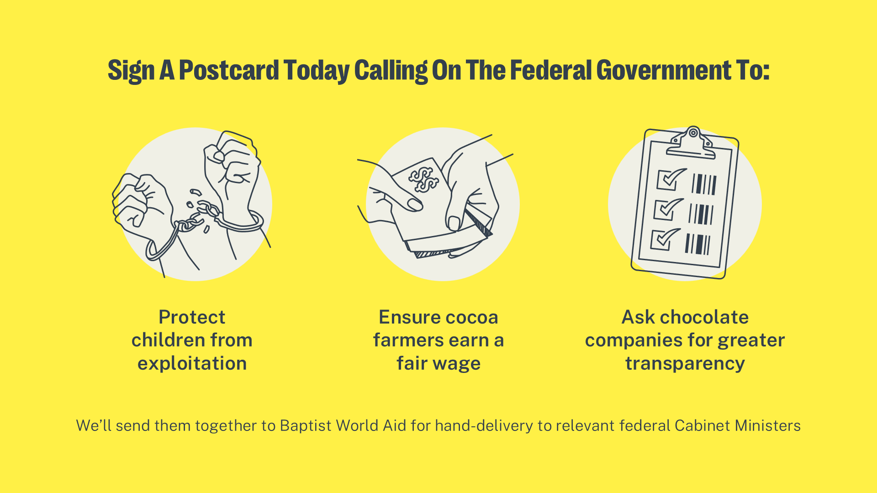
Notes:
This postcard campaign calls on the Federal Government to make policy changes that better protect children in the cocoa industry and ensure cocoa farmers earn a fair wage, reducing the economic pressure that drives child labour.
We want our elected leaders to take meaningful steps toward ending child labour in the chocolate industry.
After the service, you’ll find postcards available for you to sign (let people know where they can find them)
Each postcard is a simple, prewritten message asking the Government to take action. All you need to do is write your name, email and postcard, and drop the card (insert location). It’ll take less than a minute but makes a huge difference!
We’ll collect all the postcards from our church and send them together to Baptist World Aid, who will pass them on to key Federal Government ministers.

Slide 3

Notes:
Our combined voices will help amplify the call for justice.
Join Baptist World Aid and Be Slavery Free by filling out the postcards available (in the foyers/in the seats). Once filled out, hand them back to me/(contact person) so that we can strengthen the call to protect children who are trapped in the cocoa industry.

