Slide 1
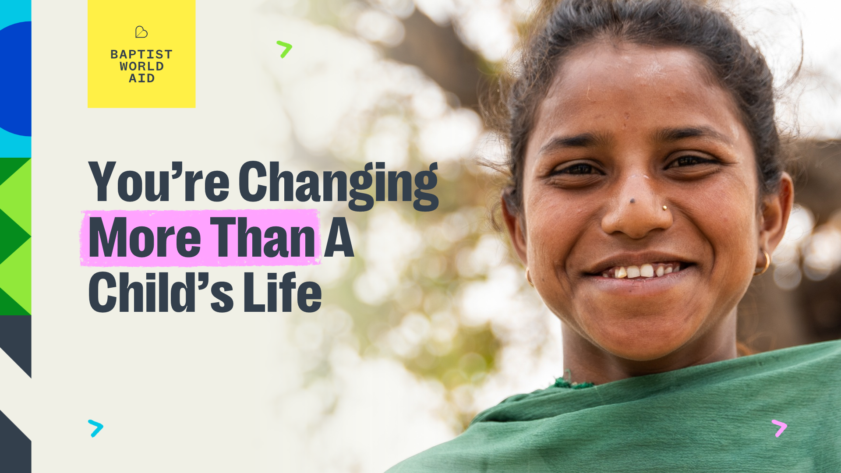
Notes:
Warm Introduction
Thank your church family for their time and support, then briefly introduce yourself and your connection to Child Sponsorship.
Example: ‘Hi everyone, I’m [Your Name], and I want to share something close to my heart—my journey with Baptist World Aid’s Child Sponsorship program and how it’s changed my life, the life of a child named [Child’s Name] and their community in [Country].’

Slide 2


My Sponsorship Story – Add Your Own Heading Here
  ↑
  Add a photo of a drawing or letter
  your child sent—it’s best not to use
  a child’s photo in public spaces.
Notes:
Share Your Story
People often connect more with information when it’s in the form of a story—and this is your story. You might choose to:
Talk about how you got involved with Child Sponsorship and why
Describe your Child Partner, their age, country, and a few personal details
Share your favourite part of supporting a child, or maybe a letter or prayer request from your Child Partner
Include some Scripture that reflects God’s heart for children and justice. Proverbs 31:8–9, Matthew 25:40, or James 1:27 are all great verses, or choose another that resonates for you.
Example: ‘I started supporting [Child’s Name], a 9-year-old from [Country], two years ago. I still remember the first letter they sent me—it was full of joy and hope. It reminded me how God works through his people to bring blessings to others.’

Slide 3
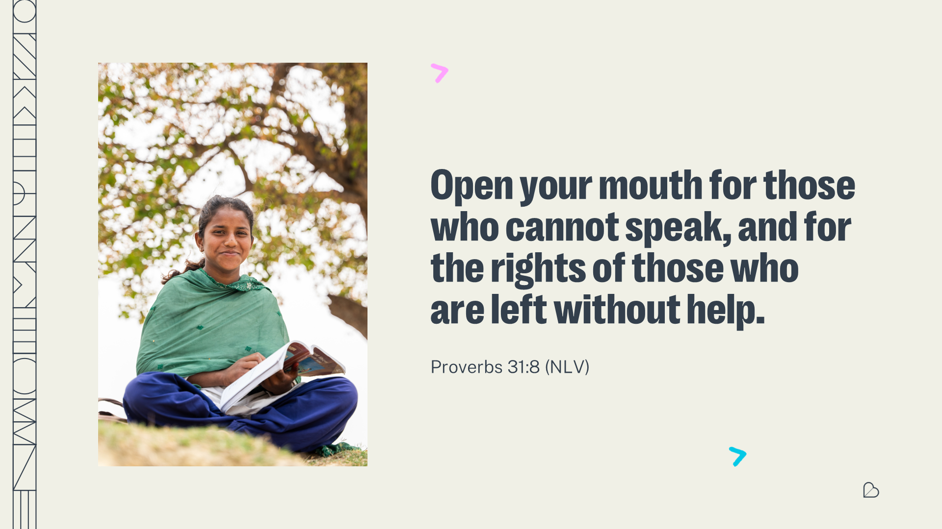
Notes:
Share Your Story
People often connect more with information when it’s in the form of a story—and this is your story. You might choose to:
Talk about how you got involved with Child Sponsorship and why
Describe your Child Partner, their age, country, and a few personal details
Share your favourite part of supporting a child, or maybe a letter or prayer request from your Child Partner
Include some Scripture that reflects God’s heart for children and justice. Proverbs 31:8–9, Matthew 25:40, or James 1:27 are all great verses, or choose another that resonates for you.
Example: ‘I started supporting [Child’s Name], a 9-year-old from [Country], two years ago. I still remember the first letter they sent me—it was full of joy and hope. It reminded me how God works through his people to bring blessings to others.’

Slide 4
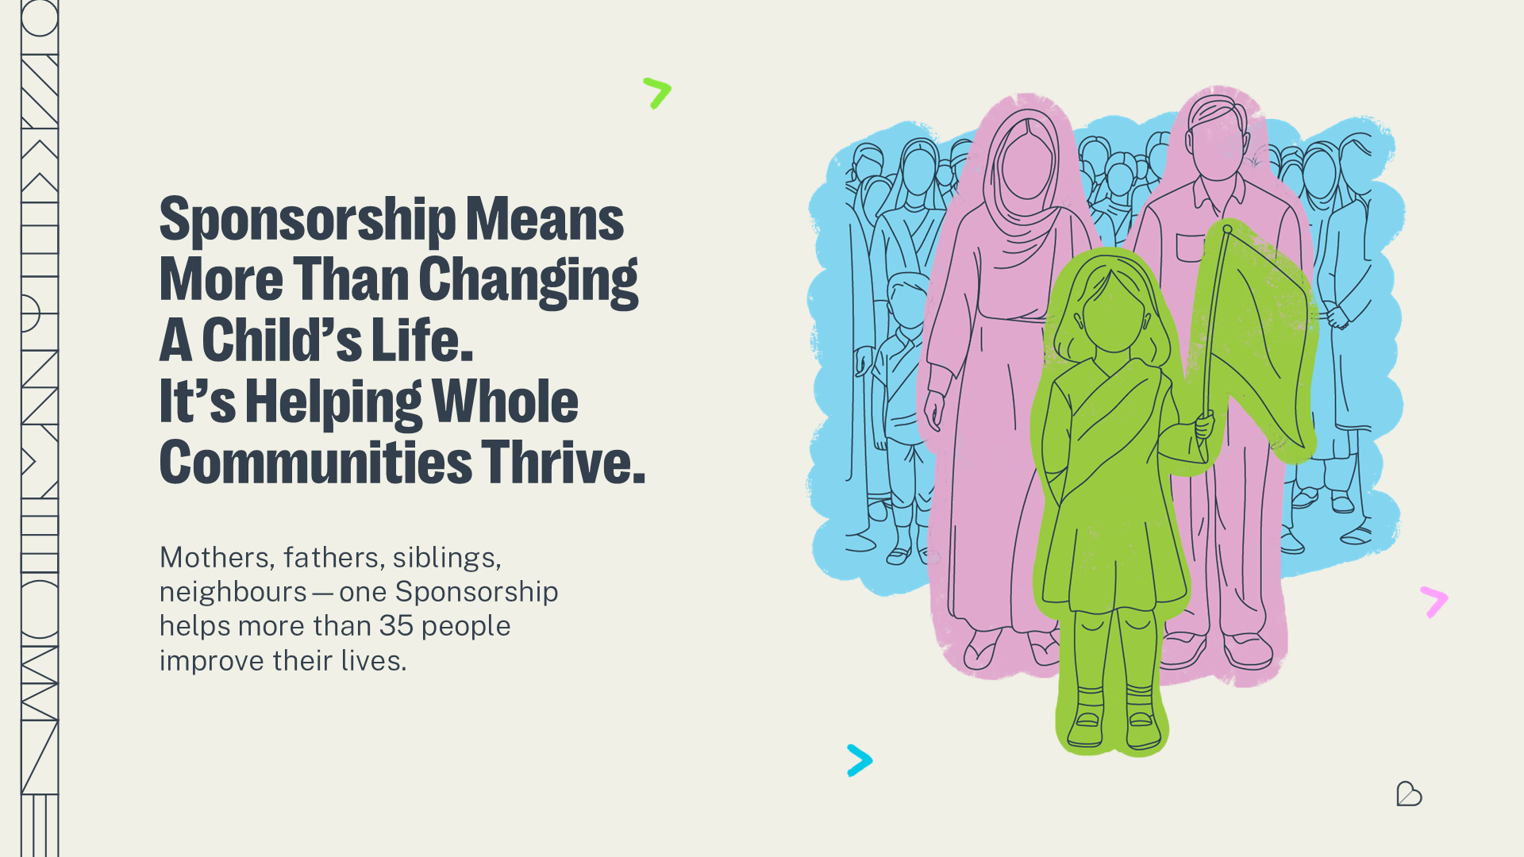
Notes:
Highlight The Impact
Explain how Sponsorship through Baptist World Aid is accredited with the Australian Government, helping a child and more than 35 people in their community access education, healthcare, and community support.
You might also like to share why you choose to sponsor with Baptist World Aid and what it’s meant for you.
Example: ‘Through sponsorship, [Child’s Name] and his/her siblings can go to school, receive nutritious meals, and attend Child Club where they’re developing the confidence to advocate for themselves and others. But Child Sponsorship doesn’t stop there—the whole family and community gain access to poverty fighting programs. For example, [Child Name]’s mother is also now connected to a Self Help Group where she’s learnt skills to farm goats. And this is happening throughout [Child’s Name]’s community. It’s more than supporting a child, it’s transforming a community.’

Slide 5
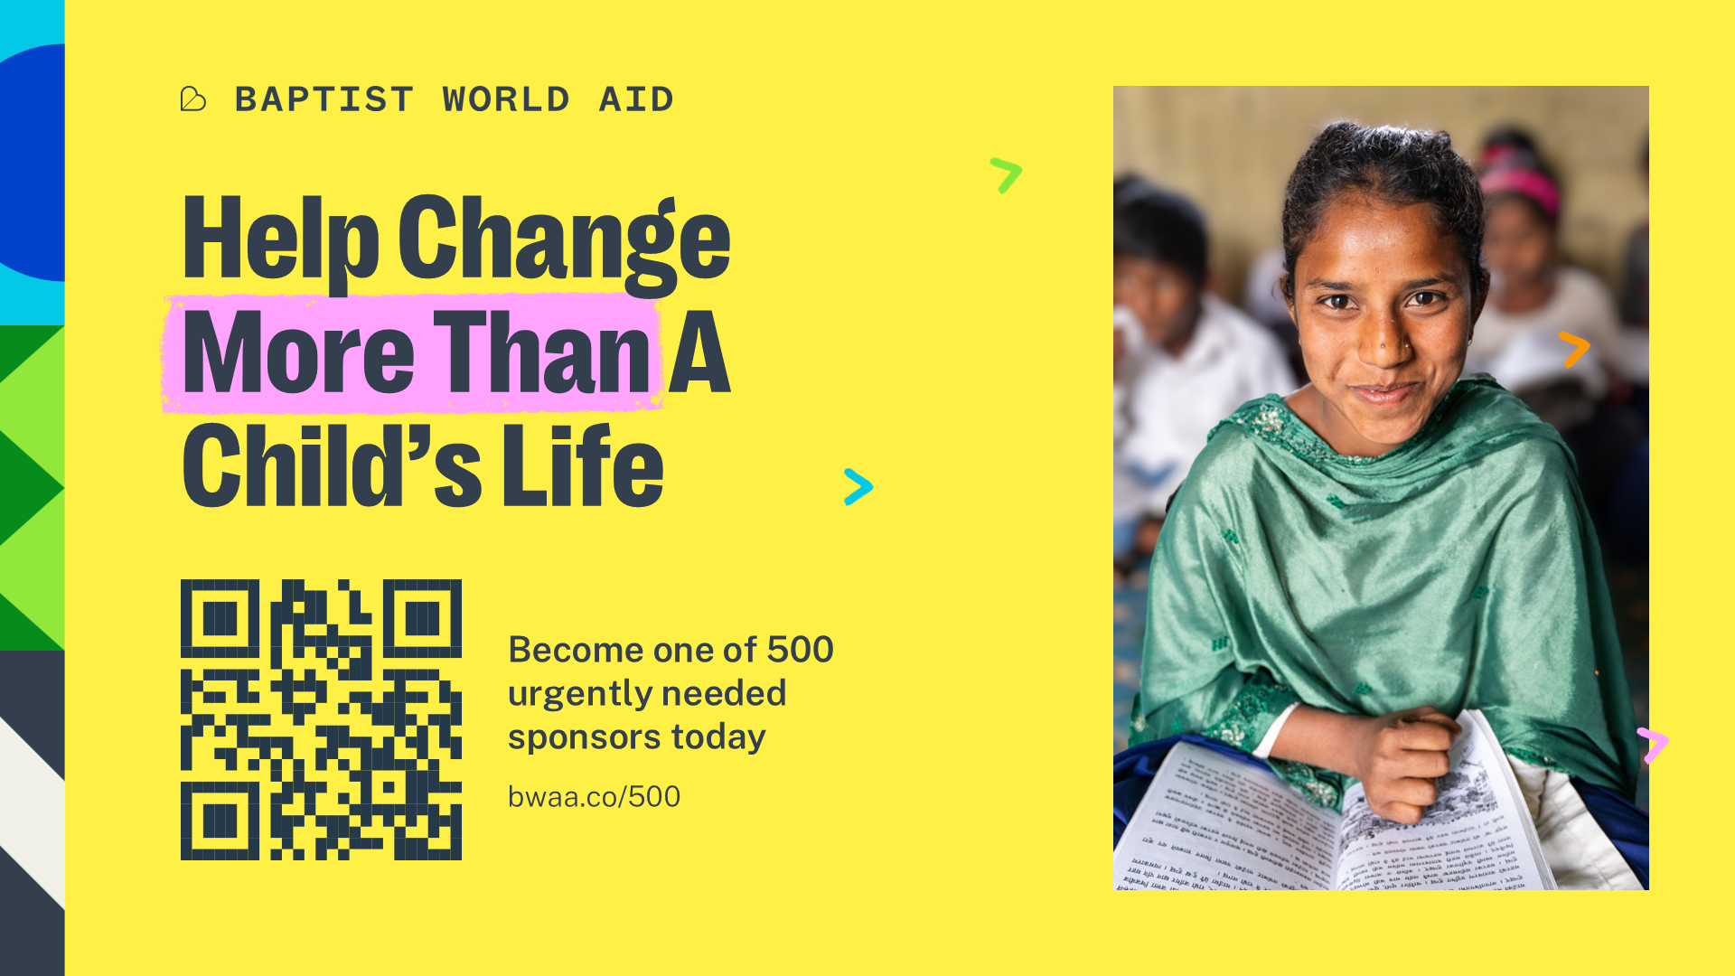
Notes:
Invite Them To Act
Make a clear and gentle call to action. You can display the PowerPoint slide with the QR code if that works for your church. If not, there are other resources with the QR code.
‘Would you consider sponsoring a child today?’
‘You can use the QR code to become a Sponsor today.’
‘If just four of us become Sponsors today, that will mean 140 people will gain access to live-changing programs!’
‘For less than $2 per day, you can make an impact for generations to come!’
‘Put your faith into action to fight inequity and poverty—through Child Sponsorship that champions and protects children, while strengthening their families and communities.’
Example: [Display slide with QR code or hold up printed materials]
‘Thank you for listening to my sponsorship story and the incredible impact Sponsorship has had on me, [Child Name] and their community. Now, I’d love to gently invite you to take action.
With more than 333 million children living in extreme poverty, would you consider sponsoring a child today? You can use the QR code on the screen—or on the handout—to become a Sponsor right now. If just four of us say yes today, that means 140 people will gain access to life-changing programs! And for less than $2 a day, you can make an impact that lasts for generations. Together, we can champion the dignity and potential of every child’
Offer Help
Let them know you’re available to answer questions or walk them through the process and share resources after the service.
Example: ‘I’ll be available up the back after this service and would love to chat and help you get signed up. I can also show you a sample profile and answer any questions you have about Baptist World Aid’s Child Sponsorship program.’

